Slide 1
Hack-X Competition Submission
Intelligent Plant Productivity System
Shalini Polimetla & Megan Dibble
September 8, 2021

Slide 2
THE CHALLENGE
Siloed Data & Systems
Inconsistent Metric Definitions
Reactive (& Disparate) Analytics
Different regions of the world have separate ERP systems with different data structures
Some data exists outside of the data lake—in spreadsheets, SharePoint lists, SQL databases, etc.
Data access permissions & SME’s to help explain data are hard to come by
Different segments of the business calculate KPI’s differently
Rolling up from the plant level detail up to the global SBD level creates challenges & confusion
There is no “source of truth” for manufacturing KPI’s globally
Excessive number of dashboards (which do not align with each other)
KPI’s show only past performance
Some KPI’s unavailable for some plants
Manufacturing plants can’t make quick changes

Slide 3
THE NEED – DEMOCRATIZATION
Taking KPI Data & Reporting That Is…
Messy
Not Standardized
Reactive
Incomplete
Confusing
Out of Sync
To a KPI Reporting System That Is…
Clean
Standard
Predictive
Comprehensive
Clear
Real-Time

Slide 4







COGITATION
Improved Data ETL & Data Blending
Consistent Metric Definitions
Predictive & Comprehensive Analytics
Using Alteryx, we can import data from any source system and blend data to create a standard structure
Once the Alteryx workflow is set up, it can run at any frequency desired
Data blending is documented inside the workflow
A single calculation method will be programmed in Alteryx to insure consistency across all manufacturing plants
Standardized features will allow for model creation
Data can be democratized at the summary level, eliminating permissions/SME needs
A single dashboard & standard, automated, plant level reports
Using machine learning, we can predict KPI values & create models for each type of KPI (e.g. Quality, HR, EH&S, etc.)
Plants can identify trends & plant managers can see where immediate action is needed to avoid “putting out fires” & instead be proactive
Can be autogenerated daily for Gemba boards/ site boards

Slide 5



IMPACT
Time Savings
Poka Yoke
Smart Alerts (AI)
Hours of manual work → Analytics in seconds
Making the process robust & mistake proof
Actionable & timely insights through AI

Slide 6
ROADMAP
Plan and Startup
Design and Execution
Validate and Transition
Deploy/ Live – Predictive Analytics
Software installations
Gathering Requirements
Data Sources connections
Start off with one plant
Schedule the auto flow process so that all the KPIs will be autogenerated every day
Can be drilled down at any granular level
Auto alert system for any actions that have to be taken
Run it parallelly with current process if any
Reconcile all the numbers
Leverage this process to other plants
Build Workflows
Integrate all the pillars
4
Week 1
Week 2
Week 3
Week 4
Week 5

Slide 7


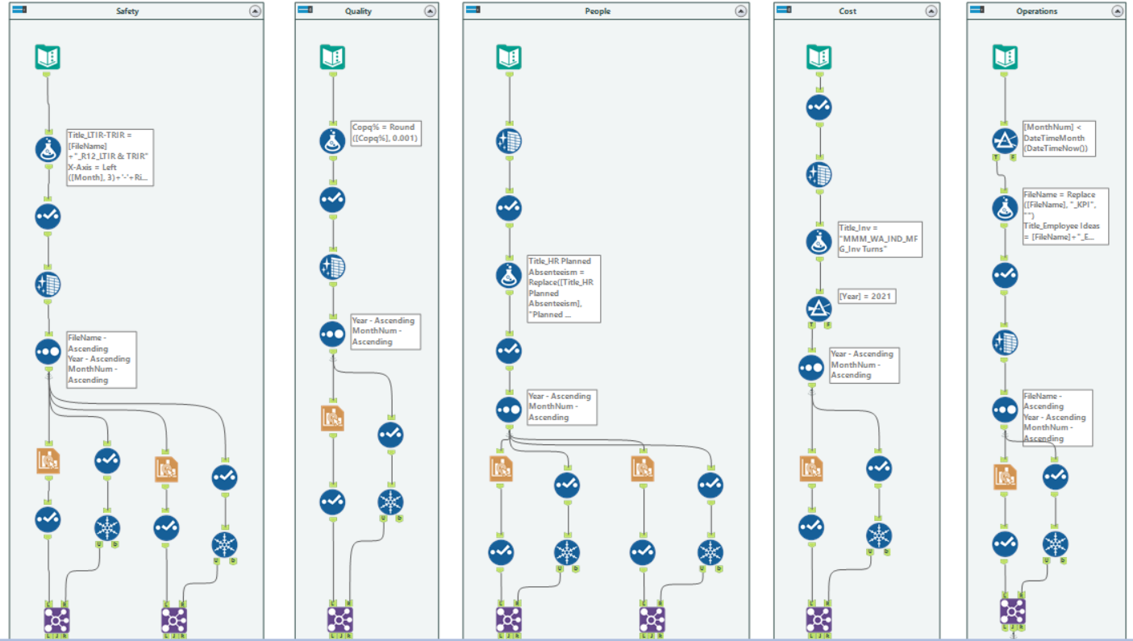

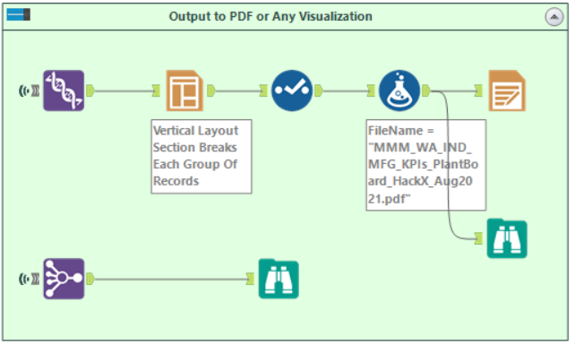

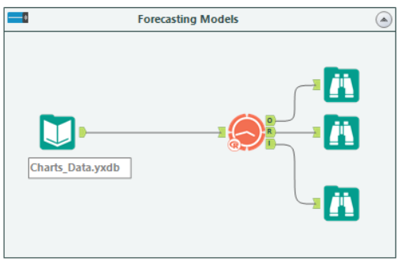
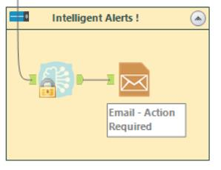
WIREFRAME
Back end – ETL and KPI calculations
2
To User – Sends emails with alert messages
(if any metric is off track and action has to be taken)
4
Note: this solution was developed in 12 hours—with more time we can leverage even more Alteryx functionality and create more features

Slide 8
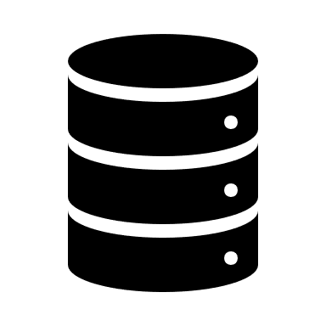


SCALABILITY AND STRATEGY
Final product will be generalized enough so that any manufacturing company can use it to create valuable KPI analytics from their data
Will be user friendly to promote adoption by the analytics teams & the plant managers
Created metrics & raw data can be stored in database to democratize data for use in other projects at the company
Can be marketed as a comprehensive solution to global KPI reporting
Selling points:
Cleans Messy Data
Creates Useful Visuals
Automates KPI Reporting
Uses ML to Predict & Alert

Slide 9
Thank you!
Reducing tedious manual efforts

